Slide 1
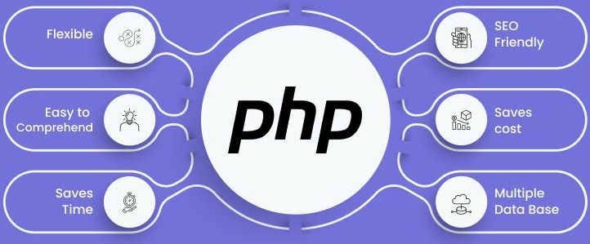

Slide 2
About today…
Web Data Formats
JSON
XML

Slide 3

Web Data Formats

Slide 4
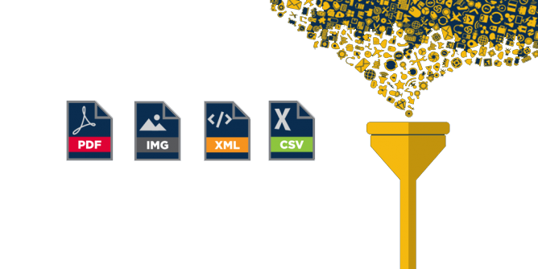
Introduction to Data Formats
Definition
Web data formats are structures that encode information to be easily
stored, transmitted, and interpreted over the web
Importance
Vital for data exchange between web systems, storage, and readability
Common Web Data Formats
JSON
JavaScript Object Notation
XML
eXtensible Markup Language

Slide 5


Slide 6

Overview of JSON
Abbreviation
JSON stands for JavaScript Object Notation
Speciality
Light-weight
Lightweight data interchange format
Human-readable
Easy to read and write by humans
Machine-readable
Easy to parse and generate
Usage
Widely used in web APIs for data exchange

Slide 7

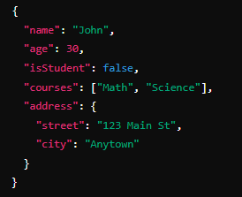
JSON Structure
Key-Value Pairs
JSON stands for JavaScript Object Notation
Keys
Always strings
Values
Can be strings, numbers, objects, arrays, true, false, or null
Example JSON Object

Slide 8


Slide 9

Overview of XML
Abbreviation
XML stands for eXtensible Markup Language
Purpose
A markup language defining rules for encoding documents
Human-readable
Easy to read and write by humans
Machine-readable
Easy to parse and generate
Usage
Common in configuration files, data transfer, document storage

Slide 10
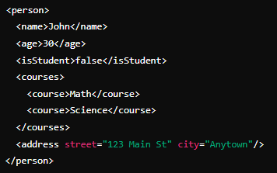

XML Structure
Tags and Attributes
Data structured with tags and attributes
Tags
Enclose data in opening and closing tags
Attributes
Provide additional information about elements
Example XML Document

Slide 11
Comparing JSON and XML
Syntax
Readibility
JSON
Key-value pairs
JSON
Easier for humans
XML
Tag-based structure
XML
More verbose
Data Types
JSON
Strings, numbers, arrays, objects, booleans, null
XML
Text and attributes (custom data type handling)
Use Cases
JSON
Popular in web APIs, JavaScript applications
XML
Used in document storage, configuration files, data transfer

Slide 12
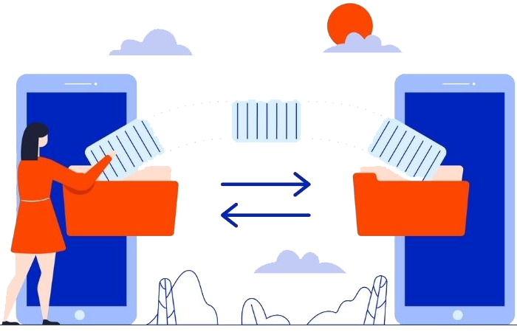
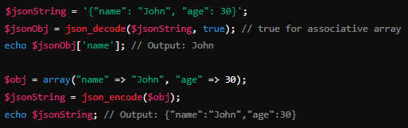
Parsing JSON in PHP
json_decode()
Convert JSON string to PHP associative array

Slide 13

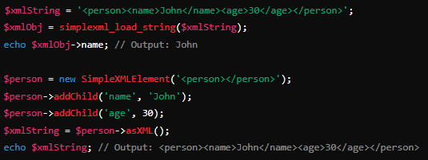
Parsing XML in PHP
SimpleXML
Parse XML string to SimpleXMLElement object

Slide 14

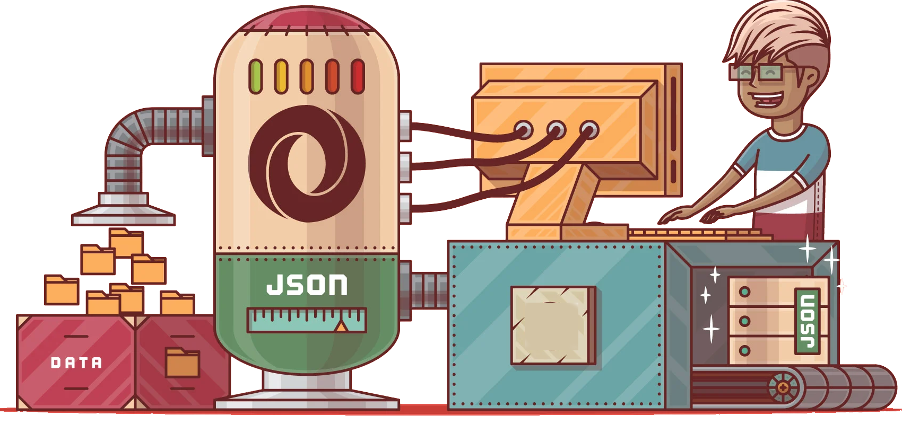
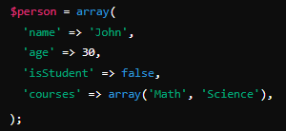
Working with JSON in PHP
Fetching JSON data from a web API using PHP
Generating JSON data in PHP

Slide 15

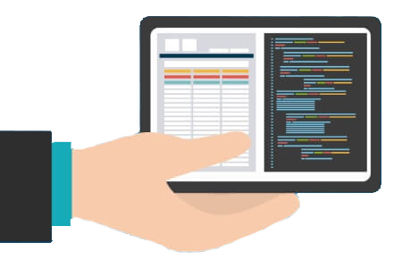




Working with XML in PHP
Fetching XML data from a web API using PHP
Generating XML data in PHP

Slide 16

Choose the right format for your use case
Validate JSON and XML data before parsing
Handle parsing errors gracefully
Use libraries and built-in functions to simplify working with JSON and XML
Keep data structures simple and consistent

Slide 17


Slide 18



Why JSON is commonly used in web development?
Used due to its lightweight and easy-to-read format, making it ideal
for data interchange between servers and web applications
How do you parse a JSON string into a PHP associative array?
You can use json_decode() function in PHP. For example
How do you load and parse an XML string into a PHP object?
You can use simplexml_load_string() function in PHP. For example:
What is the purpose of json_encode() and json_decode() functions in PHP?
json_encode()
Converts a PHP data structure into a JSON-encoded string
json_encode()
Converts a JSON string into a PHP variable

Slide 19

Task 1
Create a PHP script that handles both JSON and XML data formats. The script should be able to read data from external APIs in JSON and XML formats, parse them, and display specific information

